Slide 1
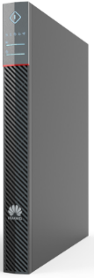

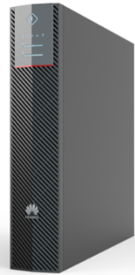
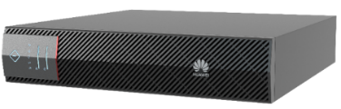
UPS2000-H
(6-10kVA)
Introduction
The FusionPower series SmartLi UPS2000-H-(6~10kVA) is an ideal power supply solution for small-sized scenarios based on the online double conversion technology. It can eliminate various power grid problems and support rack or tower installation, with a high efficiency of 96%. Small size, high power density, saving installation space. In addition, no screen design and built-in Wi-Fi for communication with the mobile app, enabling flexible monitoring of the UPS status.
UPS2000-H-6kVA
Scenarios
Small & medium enterprises, large enterprise branch offices, bank branches and other small data centers
Networks, communications systems, automatic control systems
Precision instrument and equipment
Features
Simple
Independent power-on/off button, no screen design, built-in Wi-Fi communication with mobile app, and intelligent features to comprehensively monitor the UPS status and improve intelligent application experience
The 6kVA model is 1U high and the 10kVA model is 2U high. High density and save installation space.
Efficient
Efficiency up to 96% at normal model, reduce energy consumption, green and energy-saving
In ECO mode, the efficiency reaches 99%, which is economical and reliable.
Smart
All-link iPower Monitoring, Changing Passive to AI Predictive Maintenance, Implementing Intelligent Maintenance-Free
Optional 4G modules support cloud-based management of multiple sites, reducing O&M costs.
Supports hybrid use of old and new lithium batteries and phased capacity expansion
Reliable
5kA lightning protection design, reducing lightning-related failure rate
The input power grid adaptability is optimized. The D.G. capacity meets the requirement of 1:1.35.
UPS2000-H-10kVA

Slide 2
Specifications
model |  | UPS2000-H-6KRTL-L | UPS2000-H-10KRTL-L
Rated Capacity |  | 6kVA/6kW | 10kVA/10kW
Input: Output |  | 1-in:1-out | 1-in:1-out / 3-in:1-out
Mains Input | Input Wiring | L+N+PE | L+N+PE/3Ph+N+PE
 | Rated Voltage | L-N: 220/230/240Vac
 | Input Voltage Range | L-N: 80~280Vac (176~280Vac for 100% load; 80~176Vac for 40%~100% load)
 | Input Frequency Range | 40~70Hz
 | Input THDi | THDi<3% (for 100% linear load)
 | Input Power Factor | ≥0.99 (100% Load)
Bypass Input | Input Wiring | Mains and bypass single source
 | Rated Voltage | L-N:220/230/240Vac
 | Input Frequency Range | 50/60±6Hz
Battery | Rated Voltage | Huawei SmartLi : 240V; 12 to 20 lead-acid batteries (Linearly derated to 60% if the number is less than 16)
 | Charging current | 6kVA：8A（MAX）；10kVA：15A（MAX）
System | Efficiency | Up to 96%
 | Max Number In Parallel | 4
Output | Output Wiring | L+N+PE
 | Rated Voltage | L-N: 220/230/240Vac ± 1%
 | Frequency | Tracking the bypass input (Normal mode); 50/60 Hz±0.1Hz (Battery mode)
 | Output Power Factor | 1
 | Output THDv | THDv<1% (for 100% linear load)
 | Overload Capacity | Normal mode: load≤105%, continuous work 105%<load≤125%, for 10 minutes, then transfer to bypass mode 125%<load≤150%, for 1 minute, then transfer to bypass mode Load>150%, for 200 milliseconds, then transfer to bypass mode
Environment | Operating Temperature | 0~50℃, Derating above 40°C
 | Storage Temperature | -40~70℃
 | Relative Humidity | 0%~95%(No condensing)
 | Operating Altitude | 0-1000m. Above 1000m, derating based on EN/IEC 62040-3, maximum: 4000m
 | Audible Noise | 55dB
Others | H × W × D (mm) | 43*430*514 | 86*430*514
 | Weight | 11kg | 16kg
 | Certifications | YD/T 1095-2008, EN/IEC 62040-1, EN/IEC 62040-2, EN/IEC 62040-3, TLC, CE, CB, RoHS, Reach, WEEE, etc
 | Communications | Modbus-RTU (optional SNMP / Dry contact)
Remark: For important systems that are related to important economic interests or public security, such as civil aviation management center, financial clearing center, and trading center, the Tier IV or Tier III power supply level specified in TI942 must be used. That is, two UPSs form dual-bus power supply or the UPS and mains form dual-bus power supply.
Copyright © Huawei Technologies Co., Ltd. 2020. All rights reserved.
No part of this document may be reproduced or transmitted in any form or by any means without prior written consent of Huawei Technologies Co., Ltd.

Slide 3
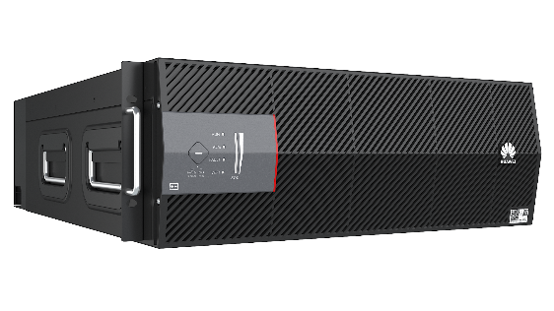
SmartLi
Introduction
A new lithium battery developed by Huawei. A single battery has a rated voltage of 240 V and a capacity of 20 Ah. It can be installed in a standard rack, which is suitable for quick installation and deployment. Fast charging and long service life．
SmartLi
Features
Long cycle life with 2500 cycles @0.5Ccharge/1C discharge, 100% DOD, 35℃.
Active current equalization, parallel capacity expansion, mixed use of old and new lithium batteries.
Specifications
Item |  | Description
Basic Parameters | Product Series | SmartLi
 | Cathode material | LiFePO4
 | Nominal voltage | 240 Vdc
 | Rated charging voltage | 260 Vdc
 | Maximum charging current | 20 A @260 V charging
 | Maximum discharge power | 7500 W @240 V discharge
 | Output voltage range | 70-320 Vdc
 | Cycle life | 2500 cycles @0.5C charge/1C discharge, 100% DOD, 70%EOL,35℃
 | Nominal capacity | 20 Ah @ 0.2C charge/0.4C discharge, 30℃ (4800 Wh @ 0.2C charge/0.4C discharge, 30℃)
 | Weight | Approx. 53.0kg
 | Dimension (W×D×H) | 442 mm×520 mm×160 mm (excluding mounting ear)
 | Communication interface | Modbus-RTU, CAN;
 | Design life | 10 years
 | operating temperature | 0-40℃
 | Storage temperature | 0-60℃
 | Transport temperature | -40-60℃
 | Relative Humidity | 5%-95%

Slide 4
Charging Curve （0.5C，25℃）
Charge Voltage
Charge Current
Charging Curve （1C，25℃）
Charge Voltage
Charge Current
Discharge Curve （7500W，25℃）
Discharge Voltage
Discharge Current

